Slide 1
Experimental Controls and Automation
Christopher Lute
8 August 2024

Slide 2
Areas of expertise
Data acquisition
Controls
Industrial communications
Electrical wiring and power

Slide 3
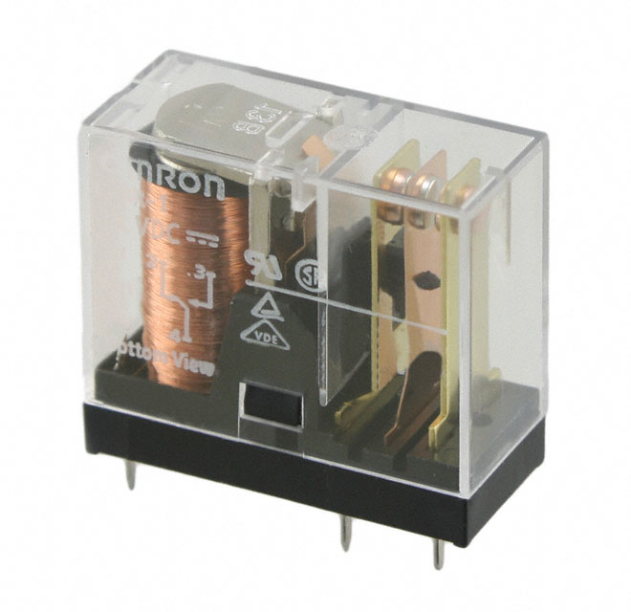
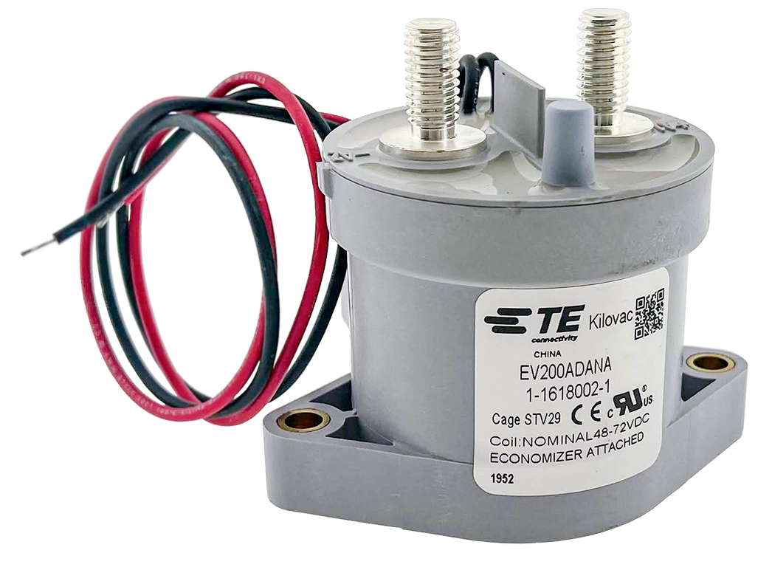
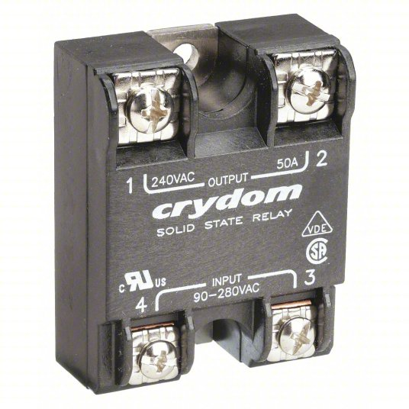
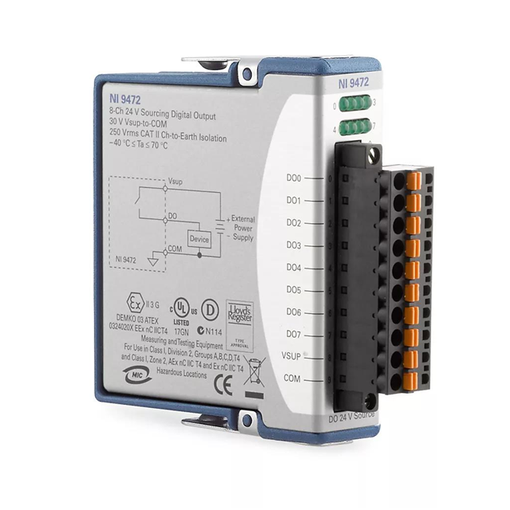

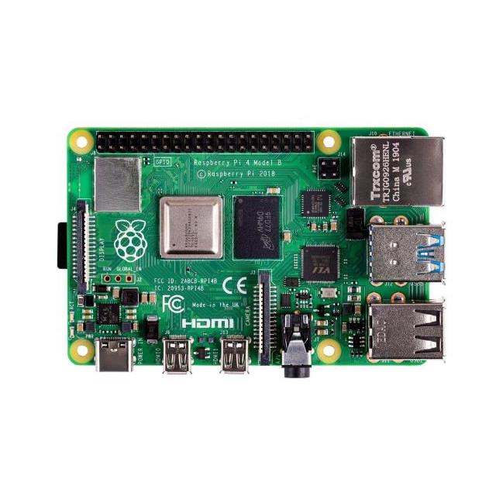
Common control devices
Relay
Contactor
Solid State Relay (SSR)
Analog/digital
Output modules
Arduino
Raspberry Pi

Slide 4
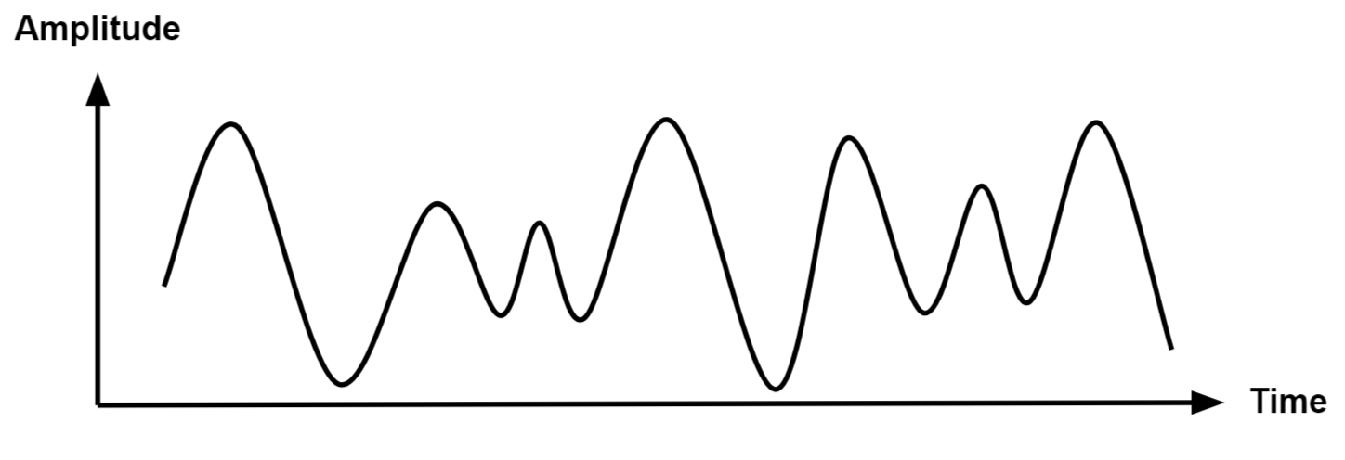
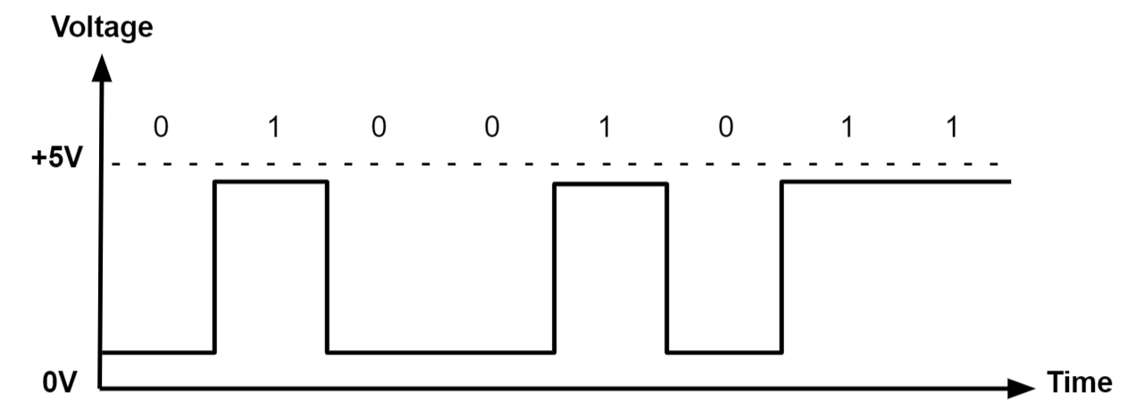
Signal types
Analog
Digital
Notes:
Common analog control signals include: 0-5 V, 0-10 V, or 4-20 mA
Digital signals are either on (true) or off (false). Common voltages for digital signals include 3.3 V, 5 V, 12 V, or 24 V

Slide 5
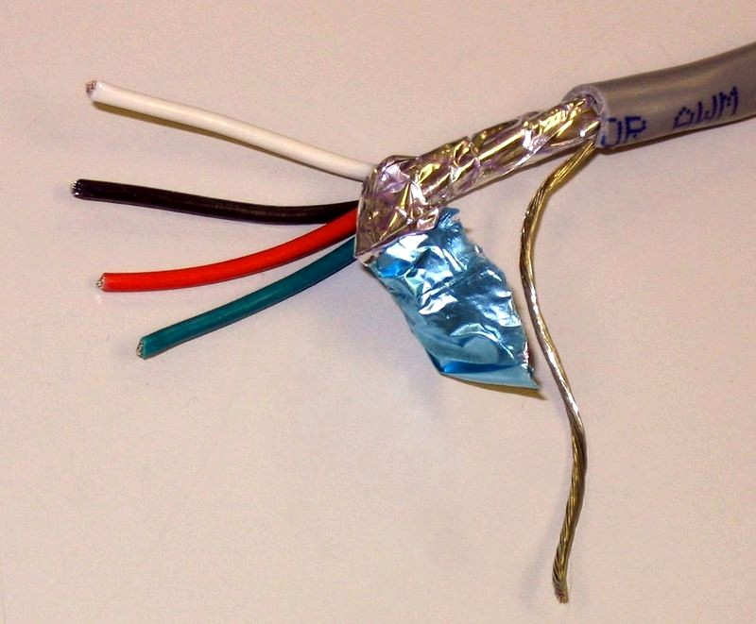
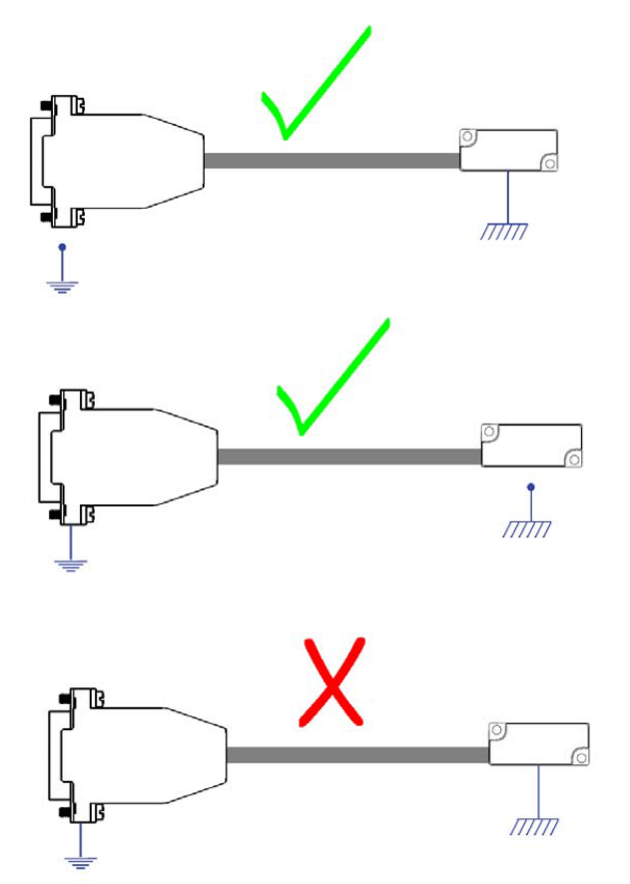
Shielded cable
Twisted pair
Twisting conductors together cancels noise
Shielded twisted pair
An outer metal foil or braid absorbs EMI before it can reach the signal conductors
Drain wire
A bare wire in continuous contact with the shield
The drain wire should be connected to earth or chassis ground at one and only one end

Slide 6
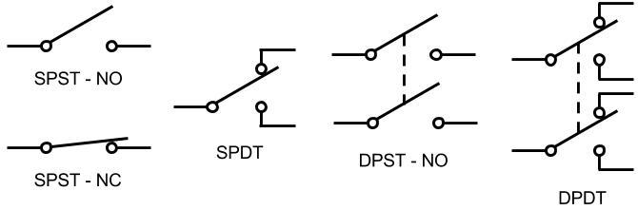
Switch types
SPST – Single Pole Single Throw
SPDT – Single Pole Double Throw
DPST – Double Pole Single Throw
DPDT – Double Pole Double Throw
NO – Normally Open
NC – Normally Closed

Slide 7
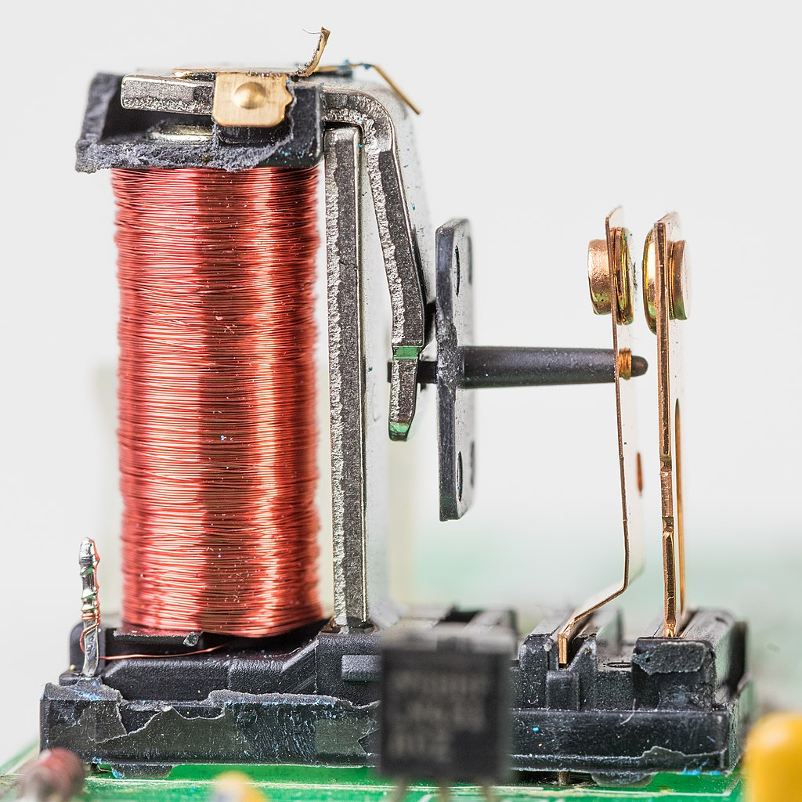
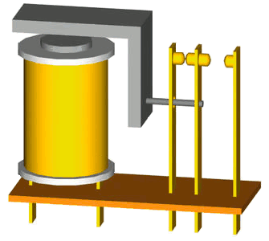
Relay
Relay
Electrically controlled switch with two parts: a coil and a contact
Many relays are double throw and will have one NO and one NC contact

Slide 8
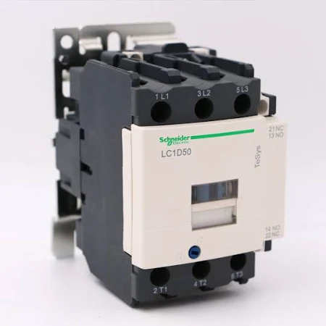
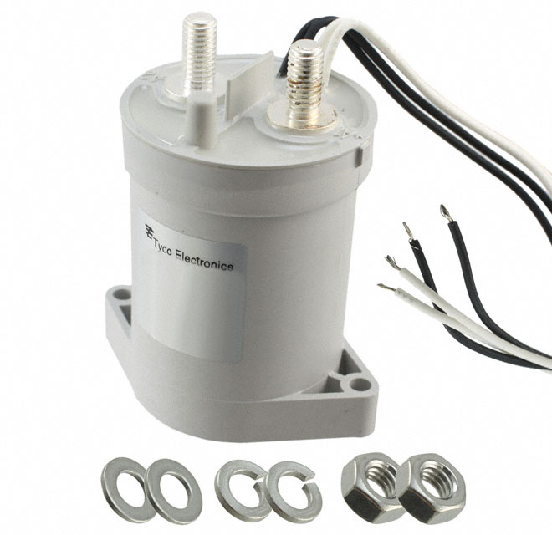
Contactors
Contactor
Same operating principles as relays but designed for higher currents
Usually single throw
Can be single pole, double pole, or three pole for controlling three phase loads like motors

Slide 9
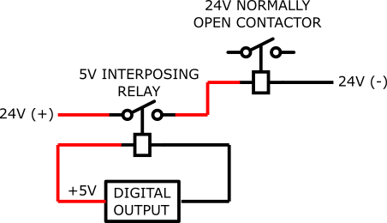
Interposing relay
Interposing relay
Interface between different voltages
Use a small, low current relay to control coil voltage for a large, normally open contactor
Notes:
Your controller may only have low voltage outputs available (e.g., 5 V) but you need to control a large relay or contactor that needs a higher coil voltage (24 VDC or 120 VAC). Or, a large contactor may need more coil current than you can drive from your digital output. Use a small relay to break the coil voltage to the larger relay. The small relay is called an interposing relay

Slide 10
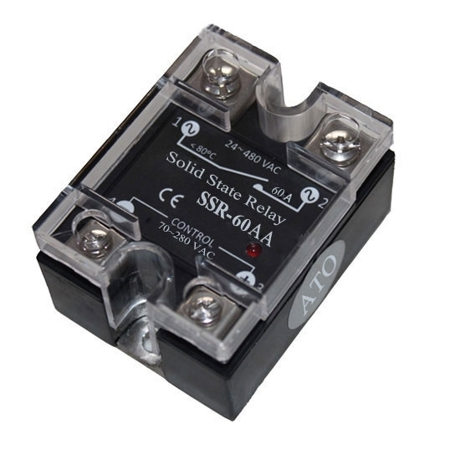
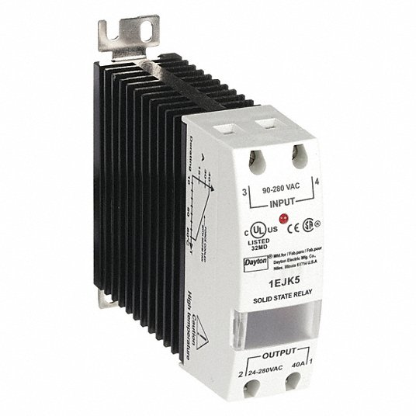
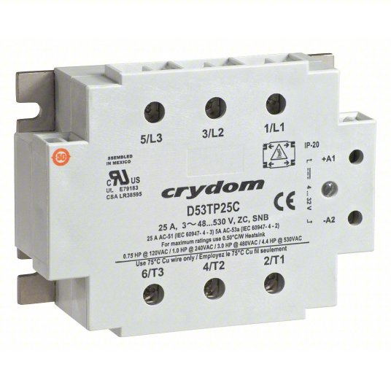
Solid State Relay
Solid State Relays (SSRs)
Electromechanical relays can only switch in the 1-10 Hz range
SSRs can switch in the 100s of Hz
SSR control inputs are typically much lower voltage and current than electromechanical relays or contactors
Notes:
Life of electromechanical relays is limited by number of switching cycles (mechanical failure)
SSRs have no moving parts and can switch much faster without mechanical failure

Slide 11
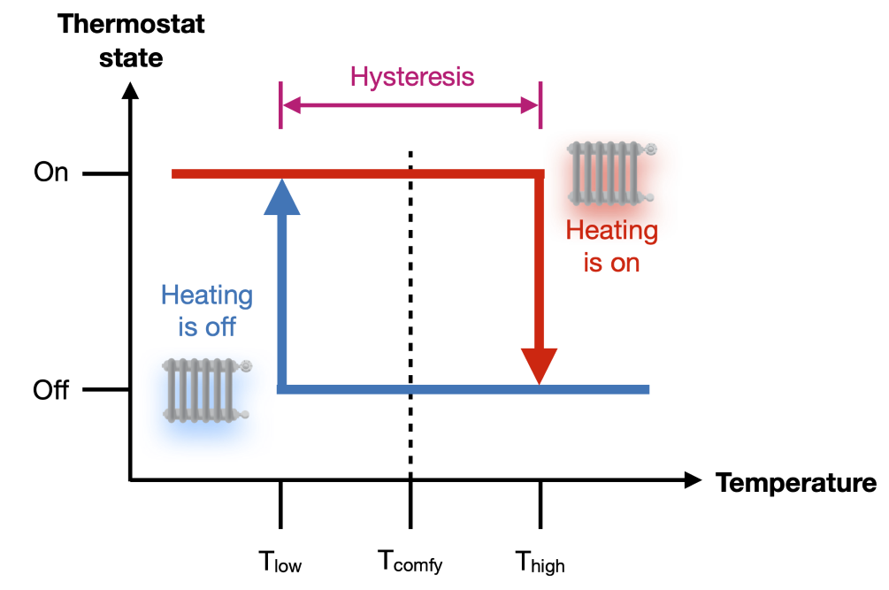
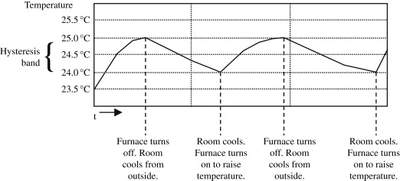
Hysteresis Control
Controller turns on when it reaches a low limit and turns off when it reaches a high limit

Slide 12
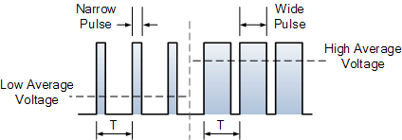
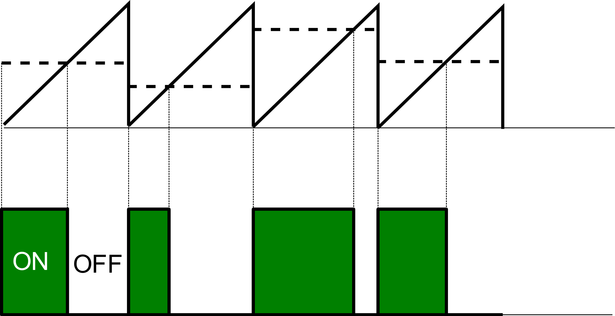
PWM Control
Uses a series of short ON and OFF pulses of varying widths to control the average value of a signal or process

Slide 13
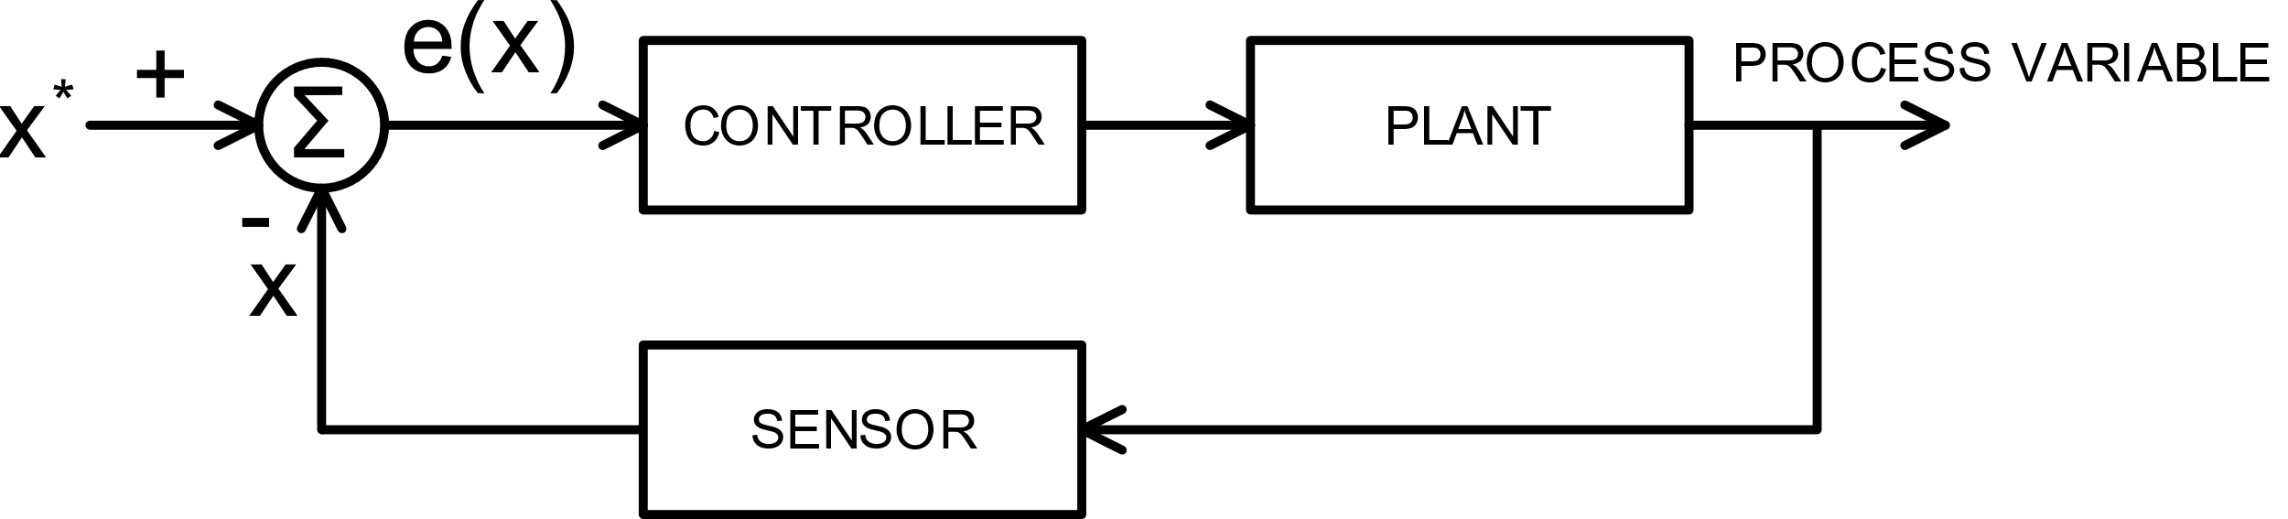
Feedback control

Slide 14
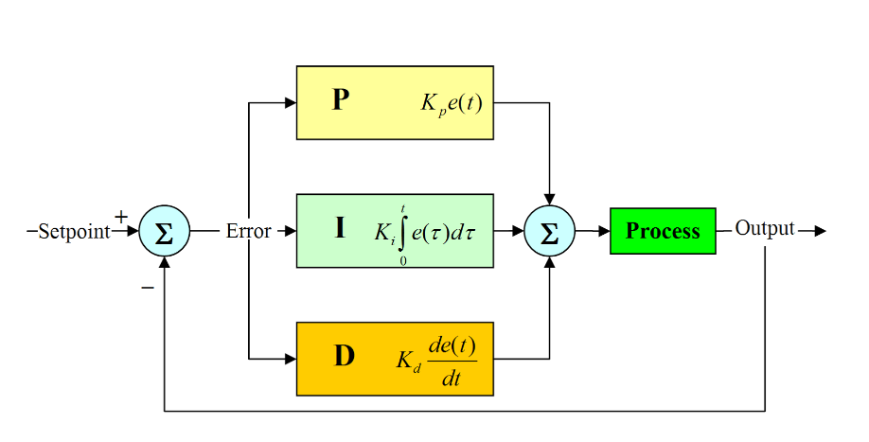
PID control

Slide 15
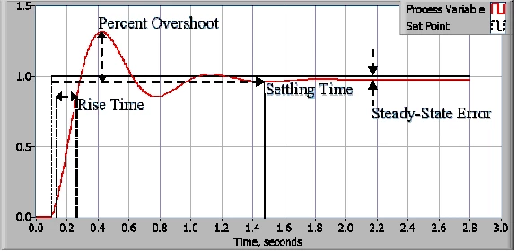
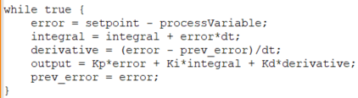
PID control

Slide 16
Repository
To learn more:
Dr. Dan Herber, Control Engineering for Systems Engineers, SYSE 511
All code can be found at: https://github.com/chris-lute/Powerhouse_research
Or email me at: chris.lute@colostate.edu

